Slide 1
From Here to There
How Investing in Workplace wellbeing can change the future of work

Slide 2
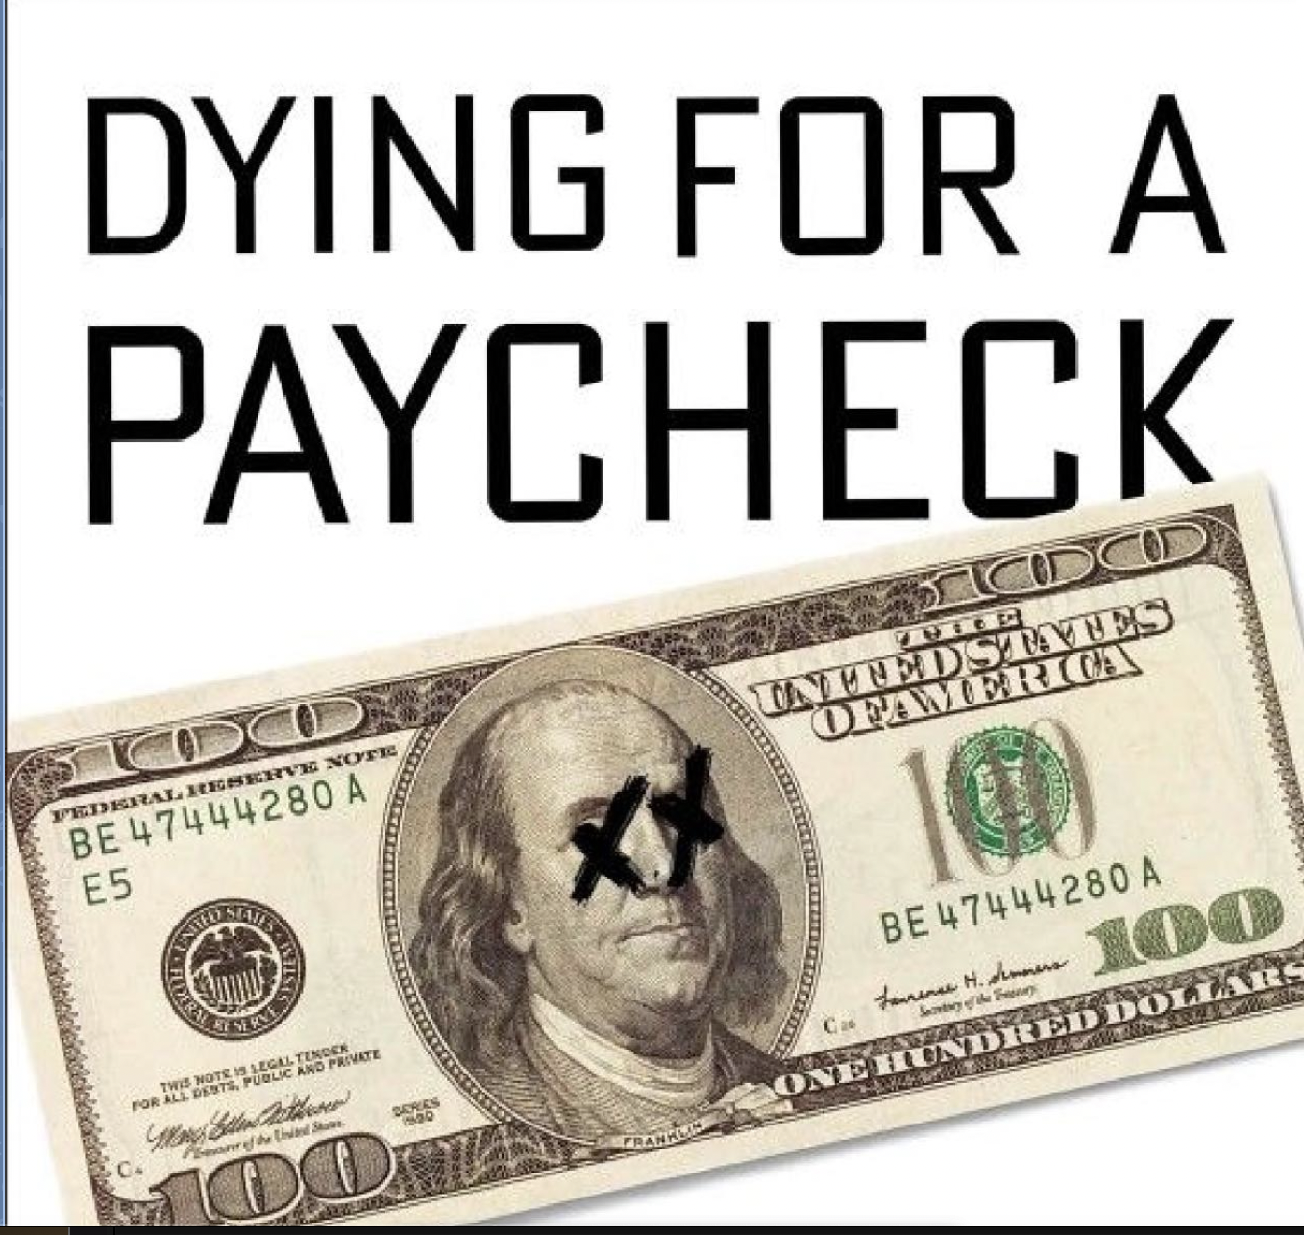
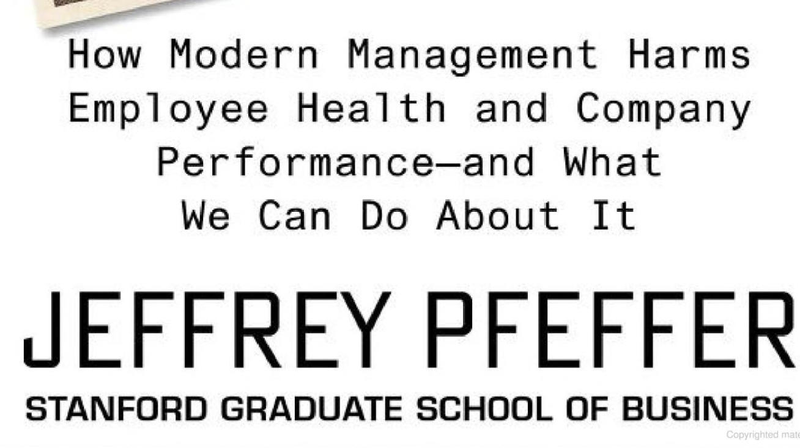
And we need to fix this!

Slide 3
Wellbeing at Work is evolving
2019 Incentive based Benefit Integration Health Cost Reduction
2020
Zombie Apocalypse
2022
Part of EVP
Recruitment and Retention
Mental health
2021
Business strategy
Stress, burnout and mental health

Slide 4
Today’s organizations fall into one of these categories
Benefits focused
Strategic Focused
Culturally Focused - EVP

Slide 5
Benefits Focused
Dealing with the new way of work
Hybrid work environment
Macro volatility
Retention
Escalating costs

Slide 6
Considerations for benefit focused organizations
To Maintain:
Wall to wall support beyond EAP
Embed mental health training w/ training
Expand measurement lens to include disability/WC
To Expand:
Acknowledge engagement is key
Partner with other HR areas
Expand measurement to broader HR and business measures

Slide 7
Strategic Focused
Resource confusion and sometimes round peg into square hole
Point of failure solutions vs. upstream solutions
Organizational and structural considerations – funding
Employee expectations

Slide 8
Considerations for strategic focused organizations
To Maintain:
Wall to wall support beyond EAP
Embed mental health training w/ training
Expand measurement lens to include disability/WC
To Expand:
Acknowledge engagement is key
Partner with other HR areas
Expand measurement to broader HR and business measures

Slide 9
Culturally Focused - EVP
Mental health emerges as #1
Lack of care extenders leave us looking for answers
Employee Assistance Programs were not built for the contemporary workplace
Myriad of solutions

Slide 10
Considerations for culturally focused organizations
To Maintain:
Think about mental health care extenders
Link to operations and productivity/performance
To Expand:
Design for the entire employee experience
Measure for organizational success (leading and lagging indicators)
Leaders model and support
Key part of HR culture and employee experience

Slide 11
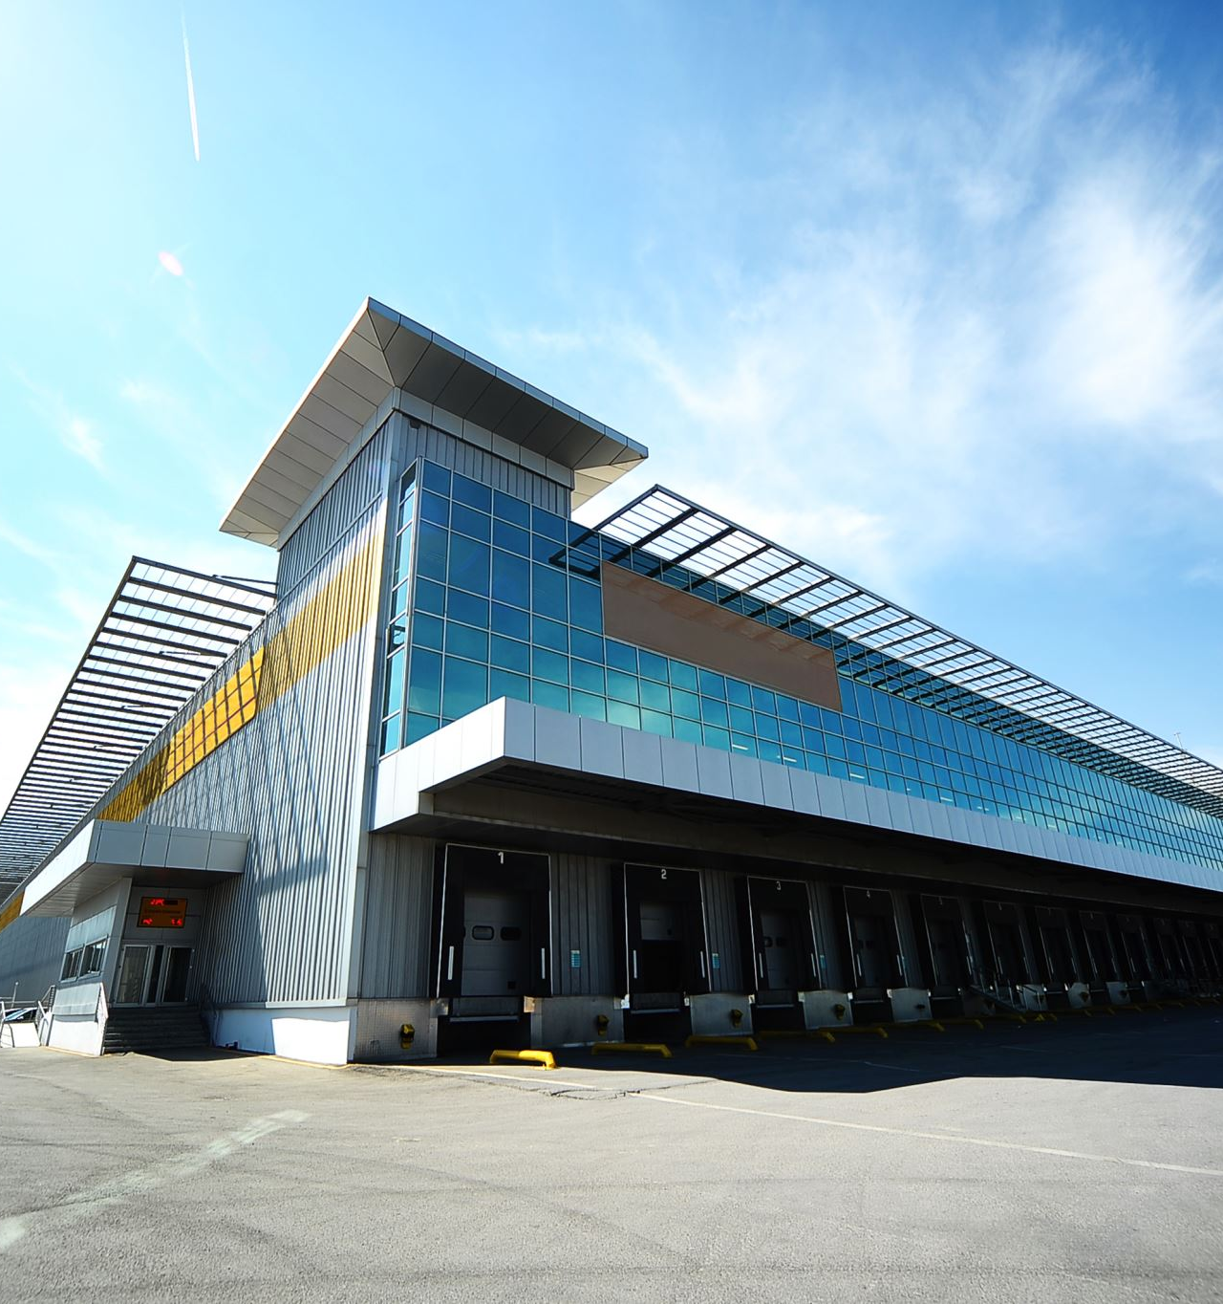
What is working?
Organizational structure matters
Offer to ALL employees – and families too!
Well-being is an outcome not a program

Slide 12
Wellbeing is evolving from a series of programs to being part of the organizational structure

Slide 13
Every successful company will become a wellbeing company
Reducing friction through work-flow integration
Training for leaders
Addressing external issues that impact work and productivity
Micro-interventions that build habits

Slide 14
Q&A

